Slide 1
Nest Data Platform
Notes:
Think of the Nest Data Platform as the engine that powers data across Nest. We collect data from many different source systems, process and govern it, and deliver trusted datasets that teams can use for reporting, analytics, and business insights. This helps ensure everyone is working from the same accurate and consistent information.

Slide 2

Data Platforms – A Place to Collate, Store and Use Data
You can think of a data platform as the memory and thinking of the company’s brain – collecting, organising and interpreting signals to make smart and timely decisions
BETTER DATA STORAGE, BETTER DATA USAGE, BETTER DATA INSIGHT
They are single location to:
  Store data
  Clean data
  Process data
  Combine data
  Create outputs from data
  Create actions from data
  Power business decisions with data
Advantages Include:
  One centralised data location
  A secure storage solution
  Data Governance ability
  Automated data processes
  Superior processing power
  Lower dependence on external systems
  Market leading technology
BETTER BUSINESS DECISIONS
They are a strategic enabler for the business, by centralising data storage and allowing data to be used across departments in uniform ways and an enabler for future cases of AI

Slide 3
Nest Data Platform
Procurement
Enabling a unified and governed analytics ecosystem
One/Single Source of Truth
NDP will unify data from multiple systems into a single, governed source, ensuring consistency across all reports and dashboards.
Automated Pipelines
NDP automates data ingestion, transformation, and loading processes—reducing manual effort and minimising data latency.
Unity Catalog Governance
Centralised data governance and lineage tracking with Unity Catalog ensures compliance, data quality, and role-based access control.
Data Availability
Streaming and incremental data processing enable up-to-date insights in Power BI, driving faster and more informed business decisions.
Sources
NDP
Outputs
Facilities
Corporate
Power BI
Finance
InfoSec

Slide 4
Implementing security and protection in data cycle
Source data
NDP
Power BI
Implemented in pipeline before ingested into NDP.
Only Data Owner & Steward would have access.
Implemented once data has been ingested in NDP.
Data Engineer would have access to ingested data.
Use RBAC
(role-based access controls)
Specific roles are created to give certain access to reports and dashbaords.

Slide 5
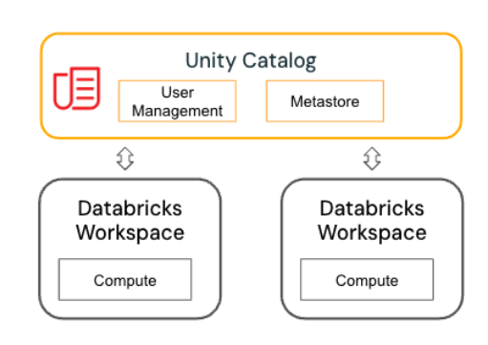
Unity Catalog
NDP Governance
Centralised Data Governance: Manage all data assets across workspaces in a single place.
Authentication and authorisation: Integrates with Microsoft Entra to verify users.
Fine-grained Access Control: Implement role-based access control (RBAC) and attribute-based access control (ABAC) to secure data assets.
Enhanced Data Lineage and Auditing: Provide automated visibility into data transformations and access history.

Slide 6
Long Term Benefits
Sensitivity - Data can be encrypted easily – if necessary, even at ingestion so the developers can’t view sensitive information
Depth of Data and Insights - Greater access to data allows investigation of previously unused data points
Cost and Flexibility - One, DACI owned, location allows more dynamism at lower costs in our reporting, modelling and insight approach
Data Governance and Quality - Data Governance has been a major concern in the past due to fragmented data storage and lack of ownership, one central platform would address this

Slide 7
Appendix

Slide 8
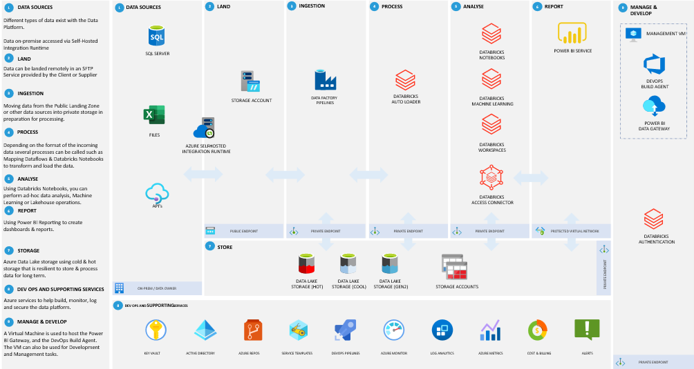
NDP High Level Architecture

